Slide 1
RANDOM FOREST
PUNEET PANDEY

Slide 2










give exam alone or give with 5 students together?
Multiple models will come together to create one single model

Slide 3

















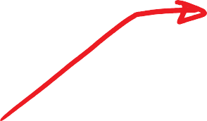
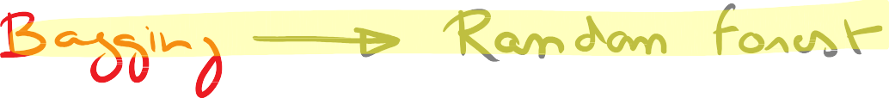

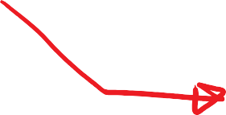





Slide 4










































































Intelligent student

Slide 5













































Slide 6

































































Slide 7





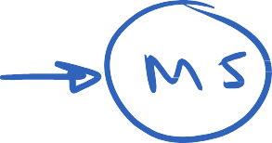






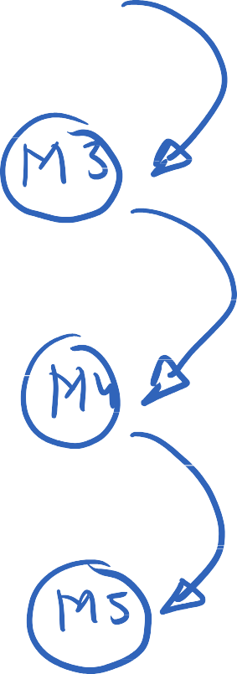

Slide 8























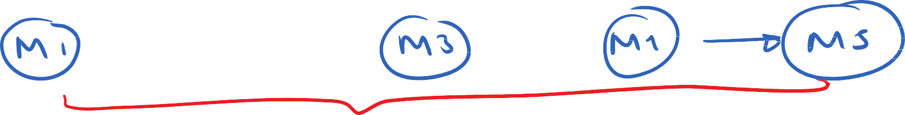








Slide 9









































Slide 10


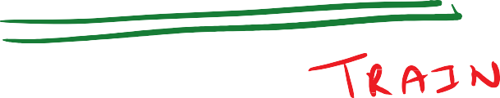
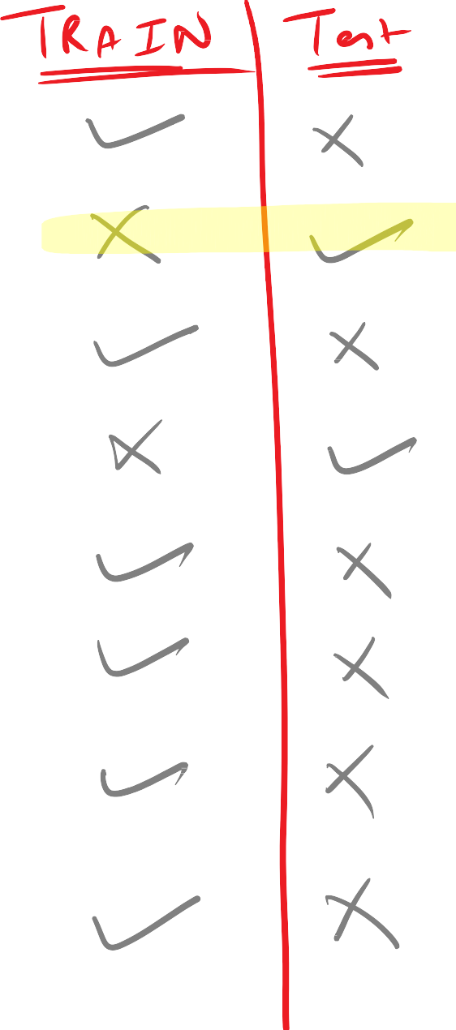
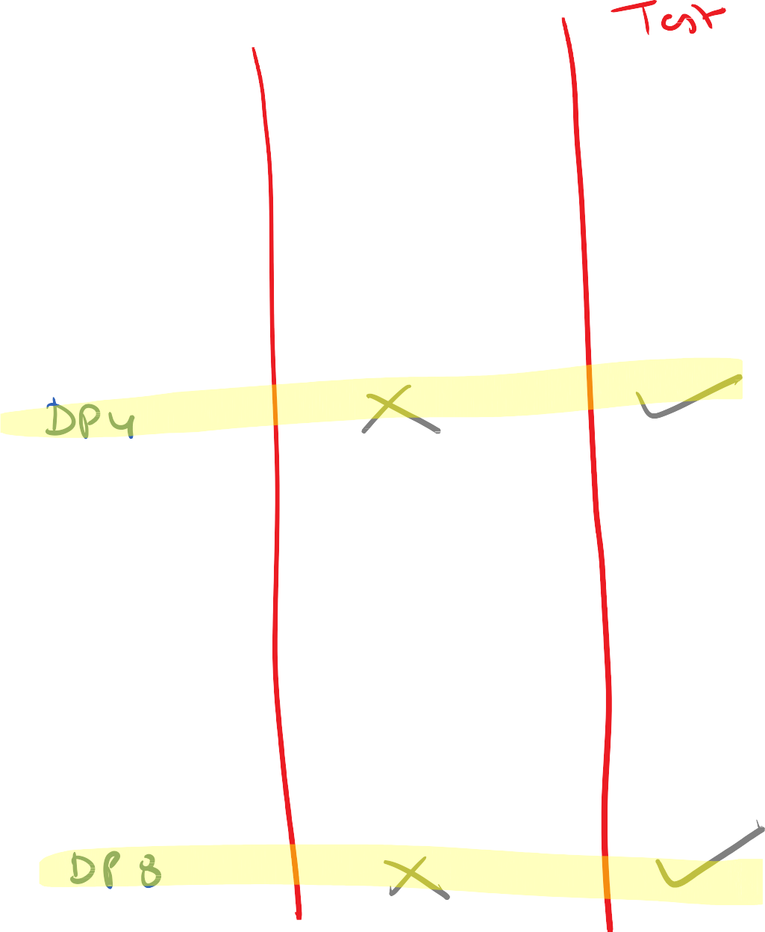










Slide 11
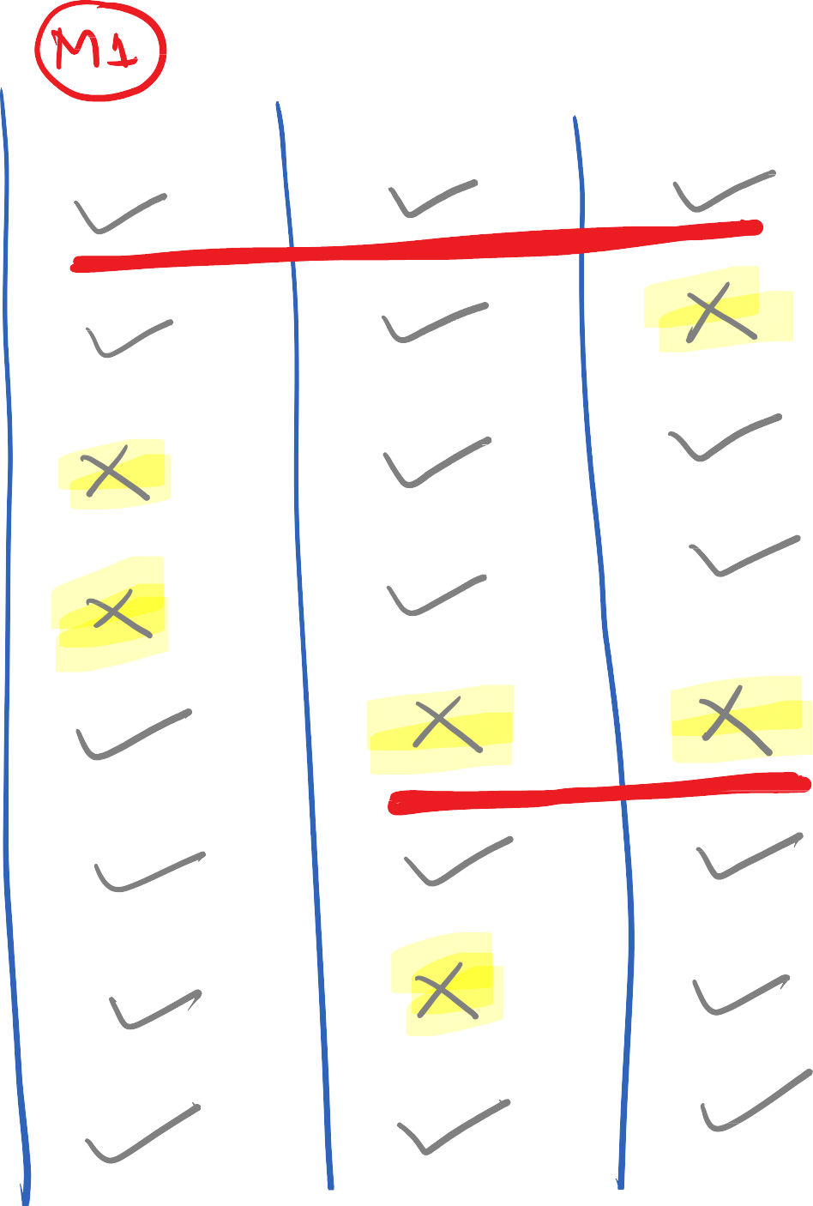


















Slide 12
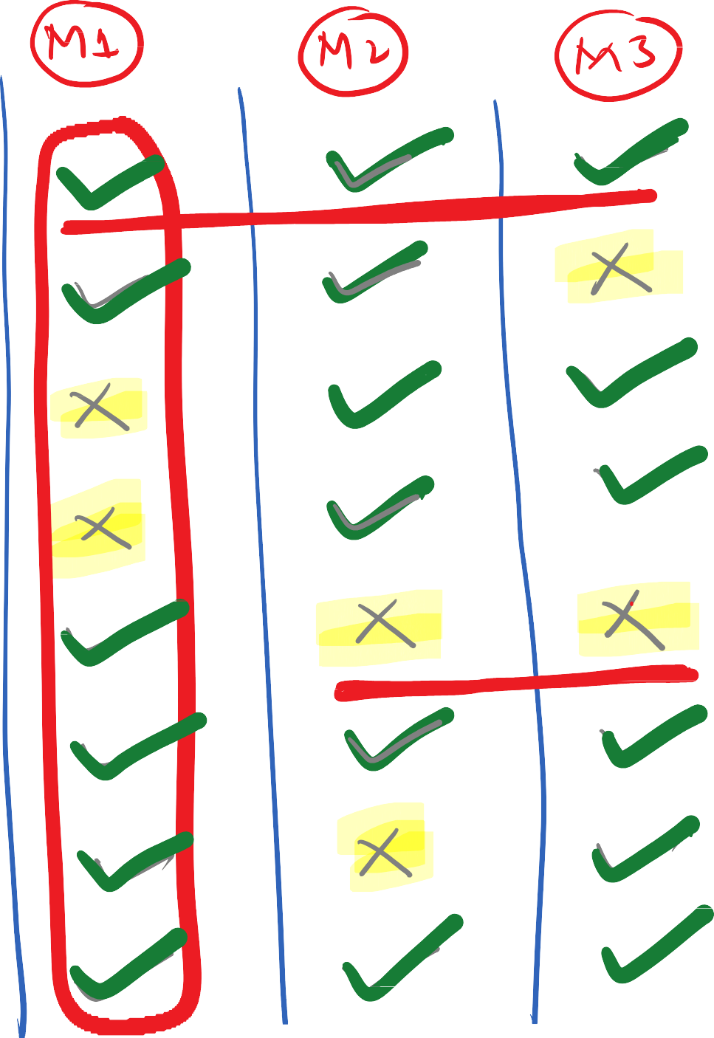
















Slide 13









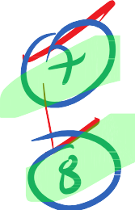

Slide 14

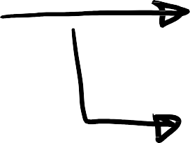

















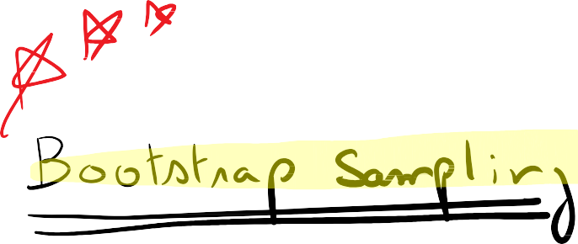












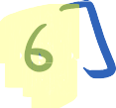



















Slide 15


WHAT ARE ENSEMBLE METHODS IN TREE BASED MODELING ?
The literary meaning of word ‘ensemble’ is group.
Ensemble methods involve group of predictive models to achieve a better accuracy and model stability.

Slide 16
WHY ENSEMBLE MODELS ARE NEEDED?
Like every other model, a tree based model also suffers from the plague of bias and variance.
Bias means, ‘how much on an average are the predicted values different from the actual value.’
Variance means, ‘how different will the predictions of the model be at the same point if different samples
are taken from the same population’.
You build a small tree and you will get a model with low variance and high bias. How do you manage to balance
the trade off between bias and variance ?
Normally, as you increase the complexity of your model, you will see a reduction in prediction error due to lower bias in the model. As you continue to make your model more complex, you end up over-fitting your model and your model will start suffering from high variance.
A champion model should maintain a balance between these two types of errors.This is known as the trade-off management of bias-variance errors. Ensemble learning is one way to execute this trade off analysis.

Slide 17
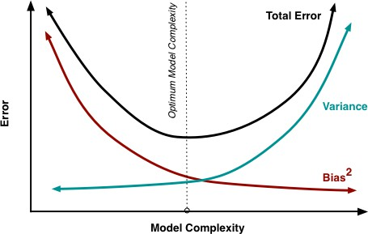

Slide 18
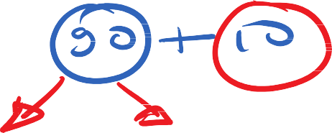



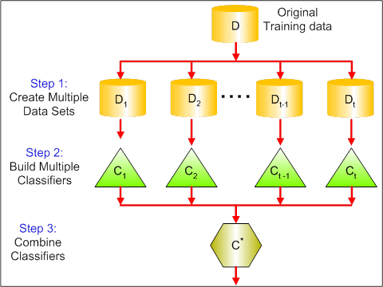














WHAT IS BAGGING? HOW DOES IT WORK?
Bagging is a technique used to reduce the variance of our predictions by combining the result of multiple classifiers modeled on different sub-samples of the same data set.
The following figure will make it clearer:

Slide 19
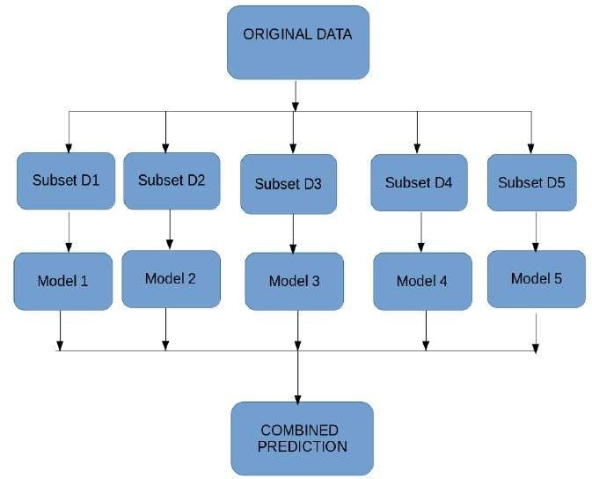




WHAT IS BAGGING? HOW DOES IT WORK?

Slide 20
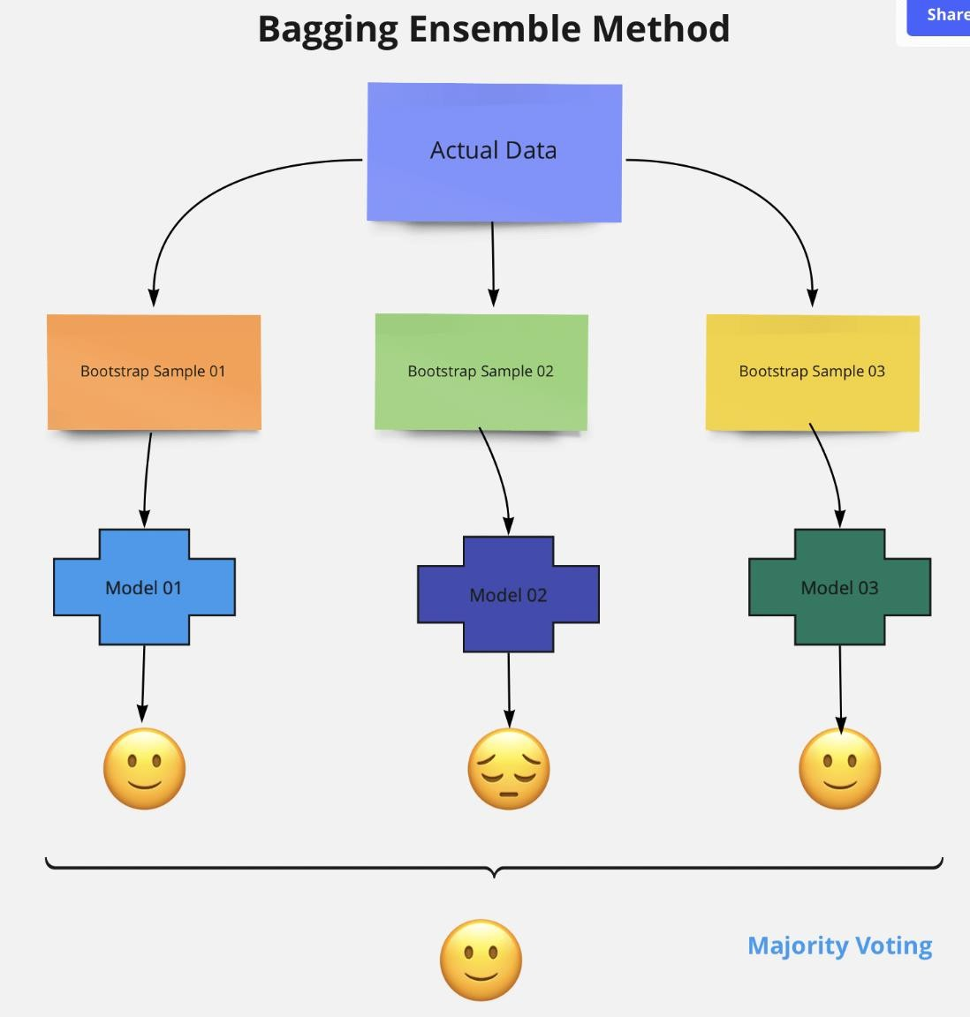








Slide 21
STEPS IN RANDOM FOREST
Step 1: In Random forest N number of random records are taken from the data set having "n" number of records.
Step 2 : Train a Decision Tree with each of the N bagged datasets as input. But, when doing a node split, don’t explore all features in the dataset. Randomly select a smaller number, M features, from all the features in training set. Then pick the best split using impurity measures, like Gini Impurity or Entropy.
Step 3 : Individual decision trees are constructed for each sample.
Step 4 : Each decision tree will generate an output.
Step 5 : Final output is considered based on Majority Voting or Averaging for Classification and regression respectively.

Slide 22
HOW DOES IT WORK?
In Random Forest, we grow multiple trees as opposed to a single tree in CART model
To classify a new object based on attributes, each tree gives a classification and we say the tree “votes” for that class.
The forest chooses the classification having the most votes (over all the trees in the forest) and in case of regression, it takes the average of outputs by different trees

Slide 23
OUT OF BAG ERROR
Random Forest involves sampling of the input data with replacement called as bootstrap sampling.
Here one third of the data is not used for training and can be used to testing.
These are called the out of bag samples.
Error estimated on these out of bag samples is known as out of bag error. Study of error estimates by Out of bag, gives evidence to show that the out-of-bag estimate is as accurate as using a test set of the same size as the training set.Therefore, using the out-of-bag error estimate removes the need for a set aside test set.

Slide 24
HOW DOES IT WORK?
Assume number of cases in the training set is N.Then, sample of these N cases is taken at random but with replacement.This sample will be the training set for growing the tree.
If there are M input variables, a number m<M is specified such that at each node, m variables are selected at random out of the M.The best split on these m is used to split the node.The value of m is held constant while we grow the forest.
Each tree is grown to the largest extent possible and there is no pruning.
Predict new data by aggregating the predictions of the ntree trees (i.e., majority votes for classification, average for regression).

